Slide 1
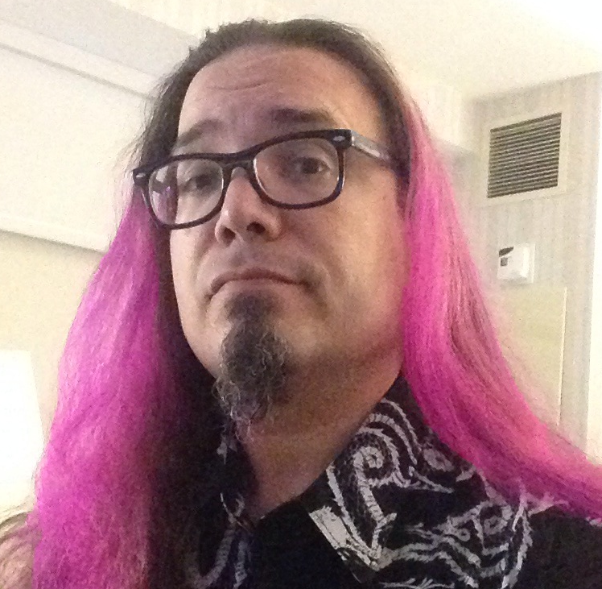
CouchDB
Gregory ("Pink")
Miller

Slide 2


Livecode Global: CouchDB
What is this all about?

Slide 3

Couch is an acronym for:
Cluster of unreliable commodity hardware
Horizontal scalability
High availability
Reliability
Even on failure prone hardware

Slide 4
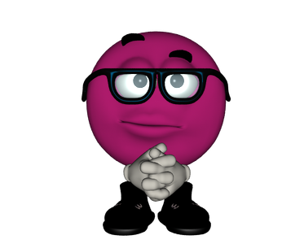

What is CouchDB?
NoSQL Database
Not tabular nor relational
Document-oriented
Data stored in JSON
Schemaless
REST API
MapReduce in javascript
Self-contained

Slide 5
Bands
id | band
101 | The Clash
101 | The Pogues
101 | 101ers
102 | The Damned
103 | Sisters of Mercy
104 | Siouxsie and the Banshees
104 | The Creatures
105 | Sex Pistols
105 | Public Image Ltd.
106 | New York Dolls
106 | The Heartbreakers
107 | The Ramones
108 | Dead Kennedys
108 | Lard
109 | Skinny Puppy
109 | KMFDM
109 | ohGr
109 | Pigface
110 | Ministry
110 | RevCo
110 | Lard
111 | Joy Division
112 | Dead Can Dance
113 | The Cult
113 | Holy Barbarians
Instruments
id | instrument
101 | guitar
101 | piano
103 | keyboard
103 | guitar
103 | bass
103 | drums
104 | guitar
105 | keyboards
105 | violin
105 | saxophone
105 | guitar
105 | bass
106 | guitar
106 | bass
107 | guitar
107 | drums
109 | keyboards
109 | guitar
110 | guitar
110 | bass
110 | keyboards
110 | mandolin
110 | saxophone
110 | drums
110 | violin
Relational Databases
Linked Tables
schema
Musicians
id | name | stagename | year_birth | year_death | nationality
101 | John Mellor | Joe Strummer | 1952 | 2002 | British
102 | David Lett | David Vanian | 1956 | null | British
103 | Andrew Taylor | Andrew Eldritch | 1959 | null | British
104 | Susan Ballion | Siouxsie Sioux | 1957 | null | British
105 | John Lydon | Johnny Rotten | 1956 | null | British
106 | John Genzale | Johnny Thunders | 1952 | 1991 | American
107 | Jeffrey Hyman | Joey Ramone | 1951 | 2001 | American
108 | Eric Boucher | Jello Biafra | 1958 | null | American
109 | Kevin Ogilve | Nivek Ogre | 1962 | null | American
110 | Alejandro Ramirez Casas | Al Jourgensen | 1958 | null | Cuban
111 | Ian Curtis | null | 1956 | 1980 | British
112 | Brendan Perry | null | 1959 | null | British
113 | Ian Astbury | null | 1962 | null | British
114 | Roger Painter | Rozz Williams | 1963 | 1998 | American
115 | Nick Cave | null | 1957 | null | Australian
116 | Carl McCoy | null | 1963 | null | British
117 | Eino Matti Toppinen | Eicca Toppinen | 1975 | null | Finnish
118 | Petrus Ratajczyk | Peter Steele | 1962 | 2010 | American
SELECT year_death, stagename
FROM musicians
WHERE year_death IS NOT NULL
ORDER BY year_death;
Musicians-1
stagename | year_death
null | 1980
Johnny Thunders | 1991
Rozz Williams | 1998
Joey Ramone | 2001
Joe Strummer | 2002
Peter Steele | 2010

Slide 6
{
"name": "John Mellor",
"stagename": "Joe Strummer",
"year_birth": 1952,
"year_death": 2002,
"nationality": "British",
"instruments": [
"guitar",
"piano"
],
"bands": [
"The Clash",
"The Pogues",
"101ers"
]
}

Slide 7
{
"name": "Susan Ballion",
"stagename": "Siouxsie Sioux",
"year_birth": 1957,
"year_death": null,
"nationality": "British",
"instruments": [
"guitar"
],
"bands": [
"Siouxsie and the Banshees",
"The Creatures"
]
}

Slide 8
{
"name": "Nick Cave",
"year_birth": 1957,
"nationality": "Australian",
"instruments": [
"guitar",
"piano",
"organ",
"drums",
"saxophone"
],
"bands": [
"Nick Cave and the Bad Seeds",
"Birthday Party"
],
"misc_facts": {
"duets": [
{"Shane MacGowan": "What a Wonderful World"},
{"Johnny Cash": "I'm So Lonesome I Could Cry"},
{"Kylie Minogue": "Where the Wild Roses Grow"}
],
"movie_appearances": [
"Wings of Desire",
"Ghosts... of the Civil Dead",
"Johnny Suede"
]
}
}

Slide 9
{
"band": "Specimen",
"year_formed": 1980,
“label": "Metropolis Records",
“current_members": [
"Zach Freeman",
"Olli Wisdom",
"Jon Klein",
"Kev Mills",
"Chris Bell",
"Johann Bley"
],
{“played_at”:[
{“theHacienda”:false},
{“CBGB”:false},
{“theBatcave”:true}
]
}
}
{
"record_company": "Factory Records",
"year_founded": 1978,
“year_closed": 1992,
“founders": [
"Tony Wilson",
"Alan Erasmus"
],
"roster": [
"Joy Division",
"Happy Mondays",
"Northside",
"A Certain Ratio",
"James",
"New Order"
]
}

Slide 10
{"total_rows":6,"offset":0,"rows":[
{"id":"7b01ece5","key":1980,"value":null},
{"id":"7b019c9d","key":1991,"value":"Johnny Thunders"},
{"id":"7b02208f","key":1998,"value":"Rozz Williams"},
{"id":"7b01b1b9","key":2001,"value":"Joey Ramone"},
{"id":"7b0131d7","key":2002,"value":"Joe Strummer"},
{"id":"7b024da5","key":2010,"value":"Peter Steele"}
]}
MapReduce Query
"dead": {
"map": "function (doc) {
if (doc.year_death != null)
{emit(doc.year_death, doc.stagename);}}”}
"nationality": {
"reduce": "_count",
"map": "function (doc)
{emit(doc.nationality, 1);}”}
{"rows":[
{"key":"American","value":5},
{"key":"Australian","value":1},
{"key":"British","value":10},
{"key":"Canadian","value":1},
{"key":"Cuban","value":1},
{"key":"Finnish","value":1}
]}

Slide 11
"age of death": {
"map": "function (doc) {
var age_at_death = doc.year_death - doc.year_birth;
var name_to_use;
if (doc.stagename != null)
name_to_use = doc.stagename
else
name_to_use = doc.name;
if (age_at_death > 0)
emit(name_to_use, age_at_death);
}"
{"total_rows":6,"offset":0,"rows":[
{"id":"artist12","key":"Ian Curtis","value":24},
{"id":"artist2","key":"Joe Strummer","value":50},
{"id":"artist8","key":"Joey Ramone","value":50},
{"id":"artist7","key":"Johnny Thunders","value":39},
{"id":"artist19","key":"Peter Steele","value":48},
{"id":"artist16","key":"Rozz Williams","value":35}
]}

Slide 12
Mango Query
{
"year_death": 2002,
"stagename": "Joe Strummer",
"name": "John Mellor"
}
{
"year_death": 1991,
"stagename": "Johnny Thunders",
"name": "John Genzale"
}
{
"year_death": 2001,
"stagename": "Joey Ramone",
"name": "Jeffrey Hyman"
}
{
"selector": {
"year_death": {
"$gt": null
}
},
"fields": ["year_death", "stagename","name"],
"limit": 3,
"skip": 0
}

Slide 13
How CouchDB is Different
Documents instead of records/rows/tuples
Key/Values instead of columns
Self-contained documents instead of linked/joined tables
Multi-version concurrency control (MVCC) instead of locks
Schemaless - data does not need to be predefined, can be altered
Upload documents instead of inserting values
Design documents with MapReduce instead of SQL
With RDBMS, you need to know what your data will look like
With CouchDB, you need to know how you will use your data
RDBMS has been around along time and is widely available

Slide 14
Daybed - CouchDB for Livecode
https://github.com/madpink/couchdb4livecode
Gregory ("Pink")
Miller

Slide 15
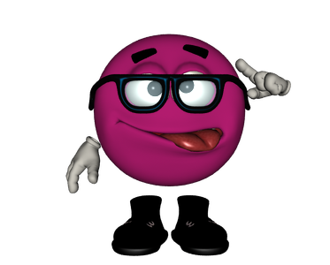
Uses fastJSON by default
Note: Made changes to the original
MergJSON only creates JSON arrays with numeric keys that go from 1 to N with no gaps (almost have this fixed)
I've had difficulties with MergJSON in Ubuntu standalones.
FastJSON is easier to use with Livecode-server

Slide 16

Main Functions
couch.get(pFunk,pURL,pDB,pDocID,pParams,pOptions)
couch.put(pFunk,pURL,pDB,pDoc,pParams,pOptions)
couch.post(pFunk,pURL,pDB,pDoc,pParams,pOptions)
couch.delete(pFunk,pURL,pDB,pDocID,pParams,pOptions)

Slide 17
pFunk - function to call, such as "all_docs" or "find"; use "db", "doc" or "ddoc" to get/put/post/delete a database, document or design-document
pURL - the URL including port http://42.23.54.1:5984
pDB - database name if applicable
pDocID - (get/delete) Document id to call
pDoc - (put/post) Document to be uploaded (should be array)
pParams - an array with any URL parameters to be added
pOptions - an array with header options and authentication

Slide 18
Building a Syncing Notes App
Gregory "Pink"
Miller

Slide 19
dbdb.stack.load pFileName pStackName pMainFolder pSubFolder pPropSet
Should be put in the "openStack" handler.
Opens save stack in the background and copies its contents to the main stack.
Creates it, if it doesn't exist.
• pFileName - file name to use for the save stack
• pStackName - name of the stack (for saving)
• pMainFolder - (optional) the main folder or specialFolder that the save stack will be saved in. Defaults:
◦ Mac and Windows: defaults to "support"
◦ iOS and Android: defaults to "document"
◦ Linux and HTML5: defaults to "home"
• pSubFolder - (optional) a folder to be created in the main folder for the save file, defaults to the short name of the stack
• pPropSet - (optional) name for the property set to save the data (useful for using the same data file for multiple apps), default: "daybedDB"

Slide 20
dbdb.local.newuser pURL pUser pPass pAuth pPrefix pOther pConflict pIDPrefix pApp
• pURL - the URL including port number of the CouchDB installation
e.g. http://127.0.0.1:5984
• pUser - User's username
• pPass - User's password
• pAuth - base64 encoded string for an administrator's username:password
• pPrefix - (optional) prefix of the database name, default: "user"
• pOther - (optional) array of other data to be saved in the user record
(e.g. email address, secret question)
• pConflict - (optional) how to handle conflicting updated:
◦ server: (default) server's copy wins conflict
◦ local: local copy wins conflict
◦ duplicate: both copies are saved, one with a modified name
• pIDPrefix - (optional) prefix for the id number of each document, default: "user"
• pApp - (optional) application name for searches, default: the same as pIDPrefix

Slide 21
dbdb.stack.save pStackName
- saves data to external stack
dbdb.local.sync
- syncs local data with database
dbdb.local.setdoc pDoc
- save pDoc to properties, flagged for sync
dbdb.local.deletedoc pDocID
- flags document in properties as deleted for sync
dbdb.local.getdoc pDocID
- loads document from properties

Slide 22
dbdb.local.sync (The Process)
Scan all local documents flagged for syncing (new, update, delete)
Query database using design document with the last sync timestamp
Compare revision numbers of local and server data
Download changed documents
Upload changed documents

Slide 23
Quick Couch Functions
qouch.init pDB,pUser,pPass,pURL
qouch.getdoc(pDocID)
qouch.putdoc(pDoc)
qouch.alldocs(pInclude)
qouch.changes(pLast,pInclude)
qouch.ddoc(pDdoc,pType,pName,pInclude)

